Slide 1
Custom Load Balancing For Chatbot Containers
Alper Çetin, 150190072, cetina19@itu.edu.tr
Advisor: Tolga Ovatman

Slide 2
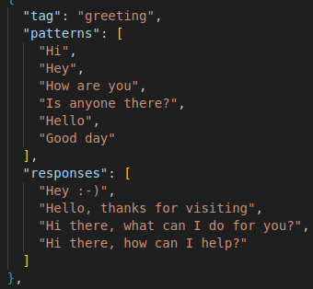
Chatbot Training
Chatbot trained with the Json file.
Json is consist of patterns and responses with tags.
Tokenize the bag of words.
Feed Forward Neural Net

Slide 3
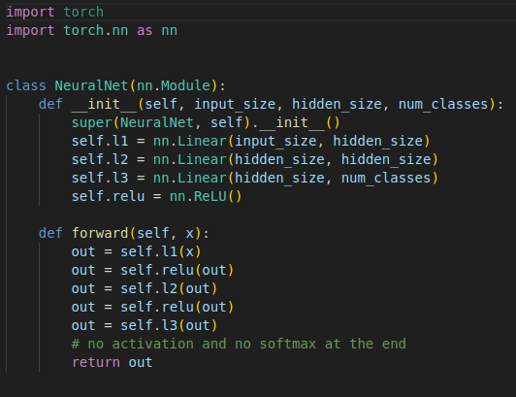
Neural Net
PyTorch and NLTK library is used
3 Linear layers (Input Size = 54, Hidden = 8, Number Of Classes = 7)
Activation function is ReLU

Slide 4
Training of Chatbot
Preprocessed data from Json file loaded into 2D matrix.
Epoch count = 1000
Learning rate is = 0.001
Criterion = Cross Entropy Loss, Optimizer = Adam
Backward processing for optimizing and reducing the loss
Trained model saved as “data.pth”

Slide 5
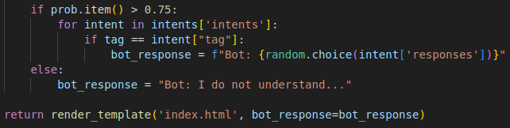
Chatbot Interface
Model is loaded from “data.pth” file
Flask framework web dashboard for the chatbot interface.
The route “/” is rendered with “index.html” file
The route “/chat” produced with the bot’s response.
If the bot cannot tag the sentence with good enough accuracy it will return answer that implies it didn’t understand

Slide 6
Dockerization
Python version 3.10.12 is used
Packages in requirements text file and nltk framework added to container
5000 port is exposed for the first chatbot container and 5001 exposed for the second container.
Container memory limit is 9 Gi, app uses 8.65 GB memory.
First container has 2 cpu units and second one is 4.
Note: One CPU unit in Kubernetes is roughly equivalent to one vCPU/Core for cloud providers or one hyperthread on bare-metal Intel processors.

Slide 7
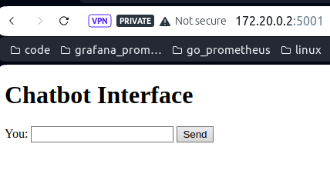
Terraform Automation
Containerization, Deployment, Horizontal Pod Scaling and Pod Ip Services done via Terraform.
Pod’s ports are exposed by the NodePort type.
Node’s ip is used to access to chabot’s interface.

Slide 8
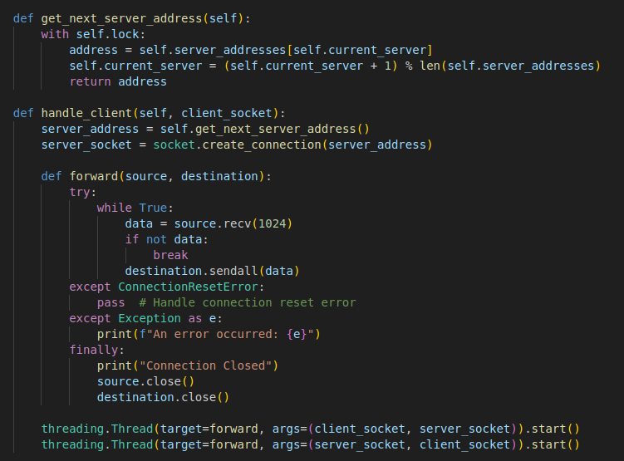
Custom Load Balancers
I’ve built 2 load balancers with weighted round-robin algorithm.
Multithreading is used for multiple server connections.
Ensuring thread safety for exceptions.
First one distributes the %75 of the load to the second, more cpu powered container
Second one distributes the %75 of the load to the first, less cpu powered container.

Slide 9
Locust Stress Test Results
First load balancer average response time with 5000 users ~ 1969 ms and failure/exception rate ~ %14
Second load balancer average response time with 5000 users ~ 2328 ms and failure/exception rate ~ %17
 | Avg Response Time (ms) | Failure Rate (%)
First Load Balancer | 1969 | 14
Second Load Balancer | 2328 | 17

Slide 10
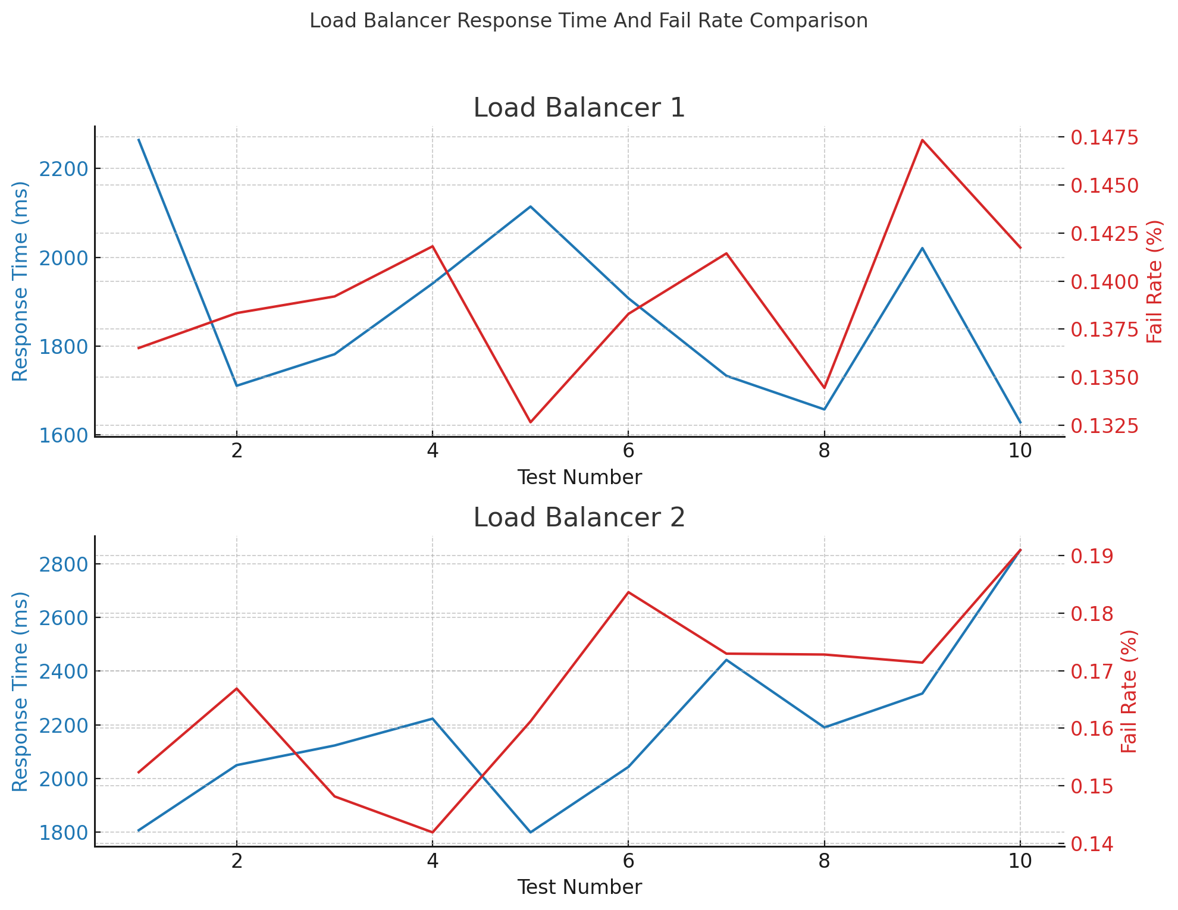

Slide 11
Project Demo
* link: Demo Video

Slide 12
Author
Alper Çetin
150190072
cetina19@itu.edu.tr

